Slide 1
The Brown Act – What a Board Member Needs to Know
August 5, 2025
Craig Steele – Richards, Watson & Gershon

Slide 2
Open Government
"The people have the right of access to information concerning the conduct of the people's business, and, therefore, the meetings of public bodies and the writings of public officials and agencies shall be open to public scrutiny.”
  - California Constitution, Art. I, §3(b)(1)

Slide 3
Open Government
The Brown Act
  Open meetings and public participation
The Political Reform Act
  Conflicts of interest
  Gifts and perks
The Public Records Act
  Public access to government records
The Levine Act
  Political fundraising and conflicts of interest
Due Process
  Opportunity to be heard; unbiased decision-makers
  Public bidding laws

Slide 4
Purposes of the Brown Act
Public Participation in the Decision-Making Process
Public Oversight of the Decision-Making Process
Protection of public agencies’ legitimate confidentiality interests

Slide 5
Open Meeting Rule
"All meetings of the legislative body of a local agency shall be open and public, and all persons shall be permitted to attend any meeting of the legislative body of a local agency, except as otherwise provided in this chapter.”
Gov. Code § 54953(a)

Slide 6
Applies to “Legislative Bodies”
What is a “legislative body?”
  Governing body of the local agency
  Subordinate boards & commissions created by formal action of the governing body
  Standing committees with a regular meeting schedule and continuing subject matter jurisdiction
What is not a “legislative body?”
  Advisory committees, composed solely of the members of the legislative body that are less than a quorum of the legislative body

Slide 7
What is a “Meeting”?
Elements
Majority of members of body present
Same time and location (including teleconference location)
To hear, discuss, deliberate, or take action on any item
Within subject matter jurisdiction

Slide 8
Serial Meetings Are Illegal
What is an illegal serial meeting?
  Series of direct or indirect communications (through intermediaries or using technology)
  By a majority of the body
  To discuss, deliberate, or take action on any item of business or potential business
Individual briefings are okay
  “Unidirectional”
  Don’t describe views of any other members
  Don’t ask about other member’s views

Slide 9


2 Types of Illegal Serial Meetings
Hub & Spoke
Chain
B
C
B
D
A
C
A
D

Slide 10
Unintentional Serial Meetings
Serial meetings in the digital age
Group e-mails and texts
Comment sections
Social Media
Twitter, Instagram, Facebook, etc. can result in inadvertent violations

Slide 11
Serial Meeting Takeaways
Avoid discussing District business with more than one other member outside a public meeting
Avoid soliciting or communicating the view of other members outside a public meeting
Avoid interacting with other members on social media about District issues

Slide 12
Tips for Electronic Communication
DO NOT:
Communicate your position on a pending matter to a majority of members
Solicit responses from other members when forwarding information you receive
REPLY ALL

Slide 13

Tips for Electronic Communication
DO: Use caution (“bcc”!) when replying to mass emails or emailing other members
Deliberations must occur publicly in a meeting.
Not by email, text, or on
social media!

Slide 14
Internet-Based Social Media Platforms (Gov’t Code 54952.2)
DO NOT:
Make, post
or share comments between members of a legislative body
Includes comments or use of digital icons that express reactions to communications made by other members of the legislative body
Applies to TWO members – majority not required

Slide 15
Internet-Based Social Media Platforms (Gov’t Code 54952.2)
OKAY TO:
Answer
questions from
the public
Provide
information to
the public
Solicit
information from the public

Slide 16
Teleconference Meetings
Traditional Rules:
  Quorum participates from within the agency’s jurisdiction (e.g., the regular location)
  Teleconference location is identified on the agenda
  Notice is posted at the teleconference site
  Teleconference location provides for public participation

Slide 17
Teleconference Meetings – Other Options
AB 2449 – just cause/emergency:
  A quorum of legislative body members must be in person at the same site, and approve.
  Only if the physical attendance quorum requirement is met
  A legislative body member may request virtual attendance because of “just cause” or as a result of “emergency circumstances.”
AB 361 - imminent risk to health & safety of attendees
  Proclaimed emergencies only

Slide 18
Meeting Exceptions
When is a meeting
not a “meeting” subject
to the Brown Act?
Individual contacts (unless serial)
Conferences and seminars
Community meetings that are open and publicized
Another body of the Agency when it is an open and noticed meeting of that body
Social or ceremonial events
Ad hoc committee meetings
Observation of standing committee meetings

Slide 19
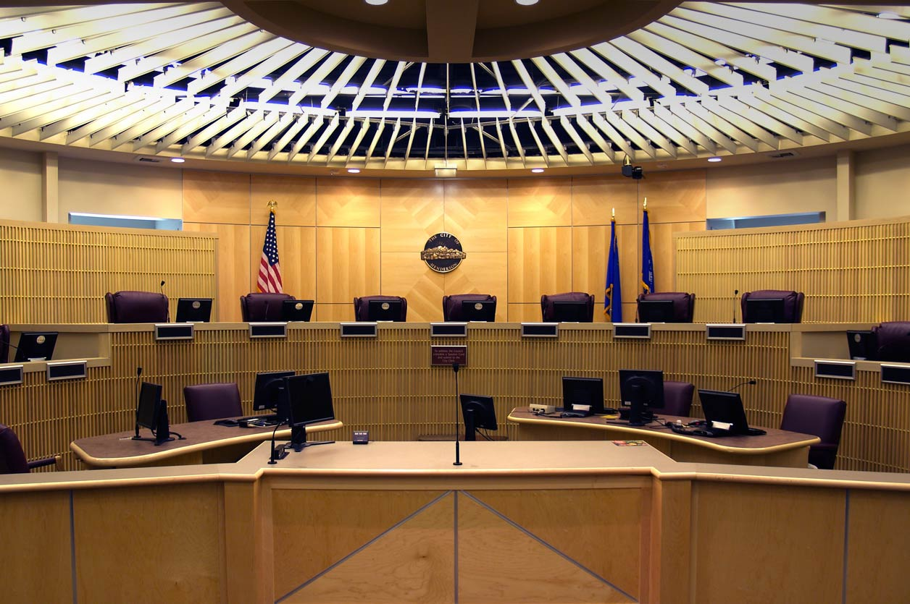
Regular Meeting
Day, time, & location set by resolution or ordinance
Agenda must be posted 72 hours in advance
General, brief description of items of business

Slide 20
Special Meeting: Special Rules
Called by presiding officer or majority of the board
Notice must be posted 24 hours in advance, stating the time, place, and agenda
Notice must be received by each member and press unless waived
Consider only items on the agenda

Slide 21

Agenda Requirements
Agendas must be publicly accessible and distributed in advance to those who request copies
Agenda must be posted on Agency’s website
Teleconference location, if any, must be included on the agenda in some cases

Slide 22
Agenda Requirements
No discussion or action on items not on the posted agenda
Absolute rule for special meetings
Limited exceptions for regular meetings

Slide 23

Adding to an Agenda
Items not on the posted agenda can be discussed and acted upon if:
Item came to the Agency’s attention after the agenda was posted and
There is an immediate need to take action before the next meeting
Two-thirds vote required

Slide 24
Agenda Requirements
Exceptions
Brief response to public comments
Questions for clarification / refer to staff
Brief announcement or report on activities
Request for future report
Agree to place item on future agenda
Emergency situation exists – requires a majority vote

Slide 25

Public Participation
The public has a
right to speak on:
Any item within the subject matter jurisdiction of the body (regular meetings only)
A specific item of business on the agenda (any meeting)

Slide 26
Public Participation
Public agencies may not prohibit public criticism of the agency or the legislative body
Reasonable regulations of public comments are allowed:
  Time limits
  Speaker cards
  Rules of decorum
  Recording permitted
Notes:
For Solvang: See Remote and In-Person Public Comment and Disruptive Speech Policy

Slide 27
Enforcement & Consequences
Types of enforcement actions:
CIVIL action to invalidate a decision or action
  District attorney or any interested person
  Notice and opportunity to cure, with commitment to refrain from alleged violation
  If not cured and there is subsequent court action, challenger can recover attorneys’ fees and costs
CRIMINAL prosecution
  Brought by the district attorney
  There must have been an action taken at a meeting in violation of the Brown Act, with intent to deprive public of information
  Misdemeanor

Slide 28
Thank you!
Craig Steele
csteele@rwglaw.com

